Slide 1
Finding Classes

Slide 2
Example 1
Scenario: Display Plant Product
Step | Actor (Manager) | System
1 | Requests to view plant categories | Displays a list of available categories—shows category name for each.
2 | Selects a category | Displays list of plant products in that category. For each shows name and short description
3 | Selects a plant product | Displays name, common name, flowering time, height, and short and long descriptions for the product.
Action 1:
Identify the nouns!

Slide 3
Example 1
Scenario: Display Plant Product
Step | Actor (Manager) | System
1 | Requests to view plant categories | Displays a list of available categories—shows category name for each.
2 | Selects a category | Displays list of plant products in that category. For each shows name and short description
3 | Selects a plant product | Displays name, common name, flowering time, height, and short and long descriptions for the product.

Slide 4
Example 1
Scenario: Display Plant Product
Step | Actor (Manager) | System
1. | Requests to view plant categories | Displays a list of available categories—shows category name for each.
2. | Selects a category | Displays list of plant products in that category. For each shows name and short description
3. | Selects a plant product | Displays name, common name, flowering time, height, and short and long descriptions for the product.

Slide 5
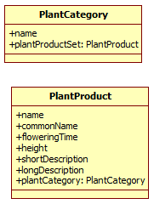
Example 1
Scenario: Display Plant Product
Step | Actor (Manager) | System
1. | Requests to view plant categories | Displays a list of available categories—shows category name for each.
2. | Selects a category | Displays list of plant products in that category. For each shows name and short description
3. | Selects a plant product | Displays name, common name, flowering time, height, and short and long descriptions for the product.

Slide 6
Example 2:
Step | Actor | System
1 | Requests student 123 | Retrieves and displays name of student 123
2 | Requests to see course sessions that student 123 is enrolled in | Retrieves and displays course sessions (course session id’s) that student 123 is enrolled in
Note: we can assume that “123” is the value of some kind of student identifier

Slide 7
Example 2:
Step | Actor | System
1 | Requests student 123 | Retrieves and displays name of student 123
2 | Requests to see course sessions that student 123 is enrolled in | Retrieves and displays course sessions (course session id’s) that student 123 is enrolled in
Note: we can assume that “123” is the value of some kind of student identifier

Slide 8
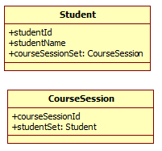
Example 2:
Step | Actor | System
1 | Requests student 123 | Retrieves and displays name of student 123
2 | Requests to see course sessions that student 123 is enrolled in | Retrieves and displays course sessions (course session id’s) that student 123 is enrolled in
Note: we can assume that “123” is the value of some kind of student identifier

Slide 9
Differentiating between classes and attributes

Slide 10
Class or Attribute?
Primitive data type?
Probably an attribute
e.g. Patient age is an integer; probably an attribute
Complex, with perhaps its own attributes?
Could be a class
e.g. Address has number, street name, unit name, and so on
Do we want to reuse it?
Could be a class
e.g. Address could be used across a system or systems

Slide 11
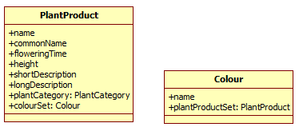
Class or Attribute? (continued)
Multiple occurrences (even though each might be simple)?
Probably a class
e.g. a PlantProduct can have many colours of flowers. Each colour is just a string but a plant can have many of them.

